Slide 1
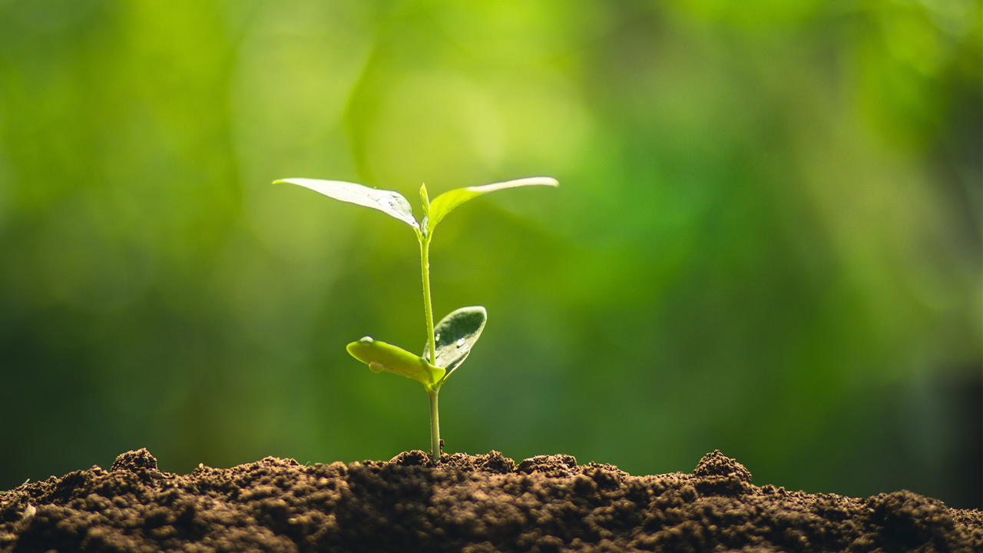
Crop Prediction
Walt Disney

Slide 2
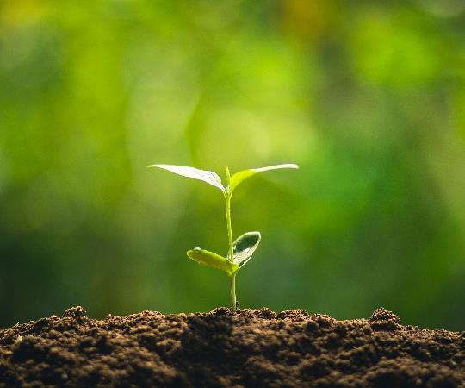

Table Of Contents :
Introduction
Literature Review
Motivation
Existing Issues
Problem Statements
Necessary Packages
Algorithm’s
Objectives
References

Slide 3

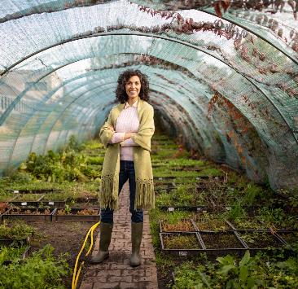
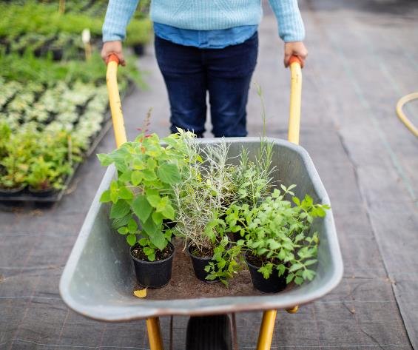
Introduction :
In general, agriculture is the backbone of India and also plays an important role in the Indian economy by providing a certain percentage of domestic products to ensure food security.
Agriculture plays a critical role in the entire life of an economy. Choosing the wrong crop for the farmer results in significant losses. Therefore, the problem with this approach is addressed to agricultural accuracy.
But now-a-days, food production and prediction is getting depleted due to excess of some crops and lack of other crops, which will adversely affect the economy of farmers by getting a poor yield and also help the farmers to remain less familiar in forecasting the future crops. This work helps the beginner farmer in such a way to guide them by predicting the crop by analyzing the past data.

Slide 4


Farmers are growing the same crops repeatedly without trying a new variety of crops and they are applying fertilizers in random quantities without knowing the efficient content and quantity. So, this is directly affecting crop yield and also causes soil acidification and damages the top layer.
In India only 51.09% is suitable for agriculture and one third(approx. 5 billion hectares) of world’s is suitable for cropping.
This research will predict which crop can get a huge demand and also give the profit to the farmers in such a way to guide them for sowing the reasonable crops.

Slide 5
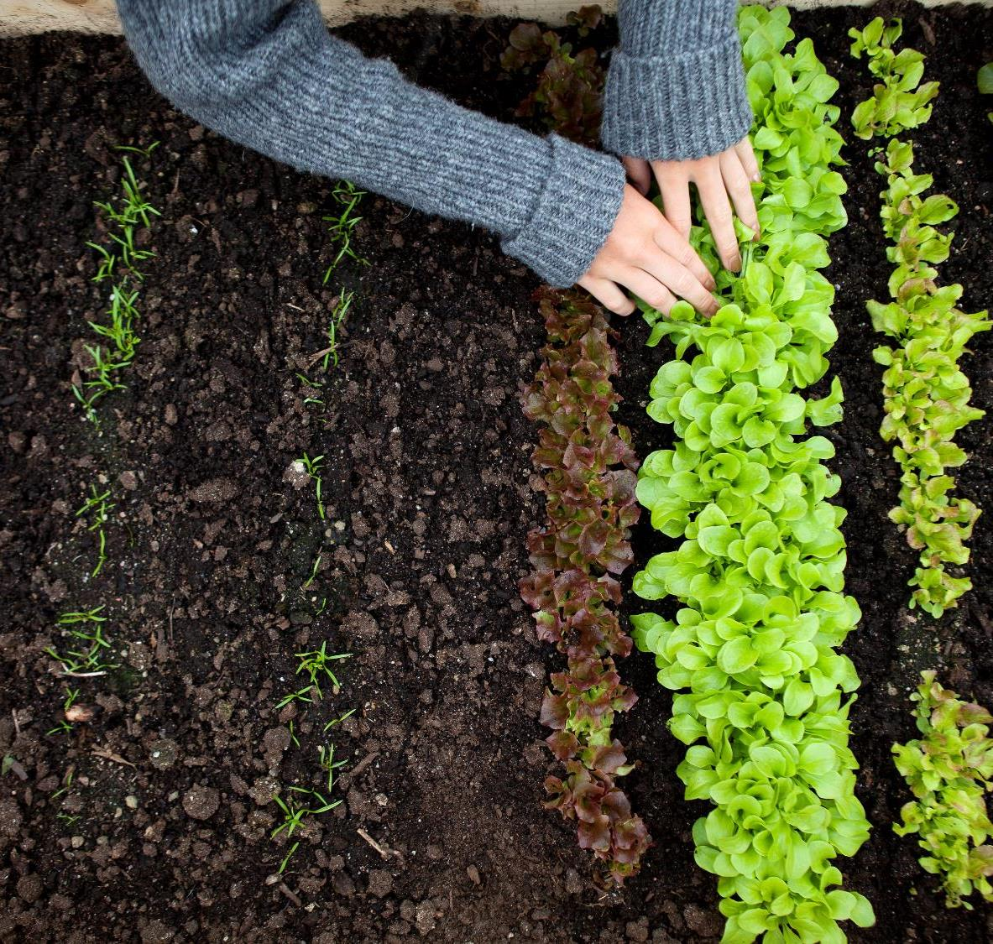
Problem Statement:
Agriculture Crop Prediction and Analysis and Recommendation of Next Crop
Farmers are facing losses due excess production or lack of production on a particular crop. By this problem not only farmers but also common people, Government, etc. are facing troubles.
The main objective of this project is to predict crops and the analysis of past crops which can be extremely useful to the farmers in planning for better yield.

Slide 6


Motivation :
Across The Globe India Is The Second Largest Country having People more than 1.3 Billion. Many People Are Dependent On The Agriculture And it is the Main Resource.
In Agriculture Cultivation/Production Having More Problems. I want to solve this Big problem in India. which is useful to many people.
"In 2020, between 720 and 811 million people faced hunger." (FAO, 2021).
World hunger is now increasing, after having declined for a decade. This trend is expected to last, while being amplified by the alarming population increase.
We need bold actions!
"In 2030, almost 660 million people may still be hungry. Hunger will not be eradicated by 2030 unless bold efforts are implemented to expedite progress, particularly actions to address significant causes of food insecurity that influence millions of people's access to food (FAO, 2021).
GDP In Indian Agriculture Sector:
2005 - 17.2 %
2012 -11.1 %
2018 – 5 %
2020 – 1%

Slide 7
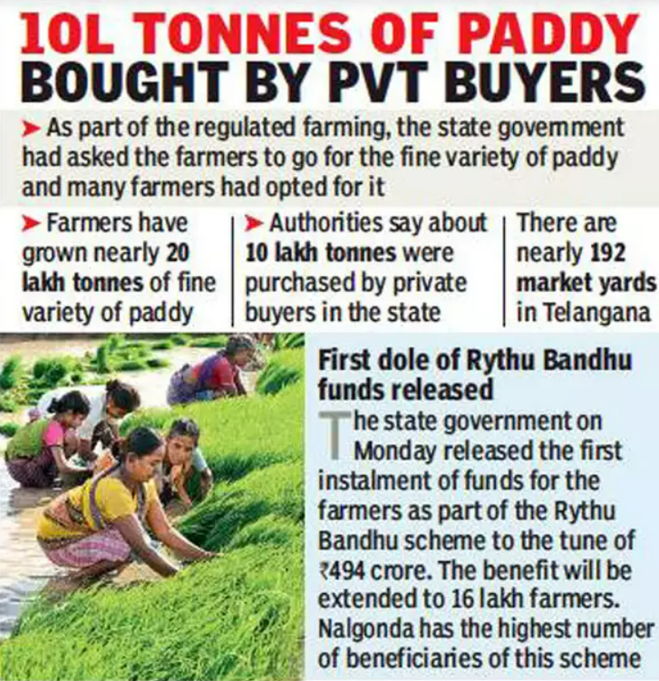
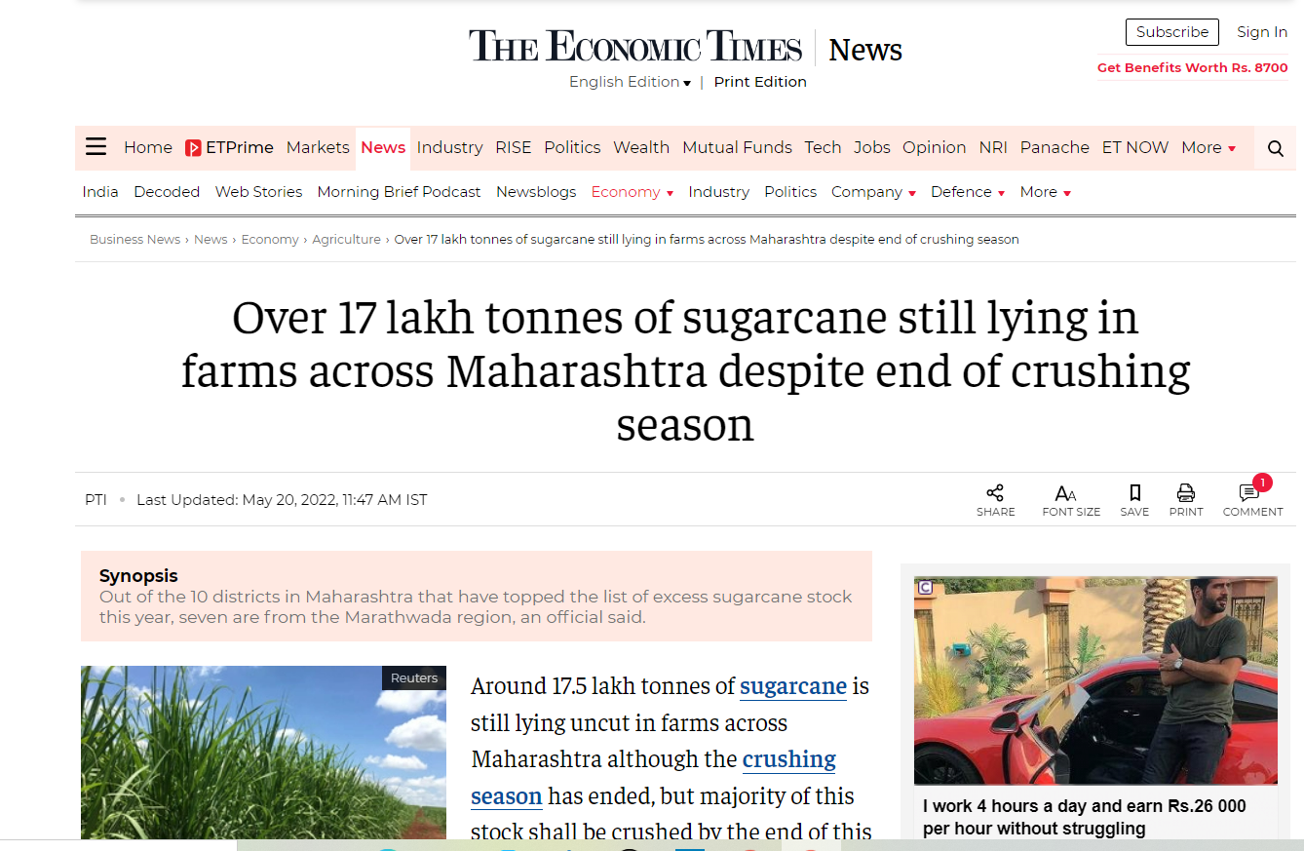
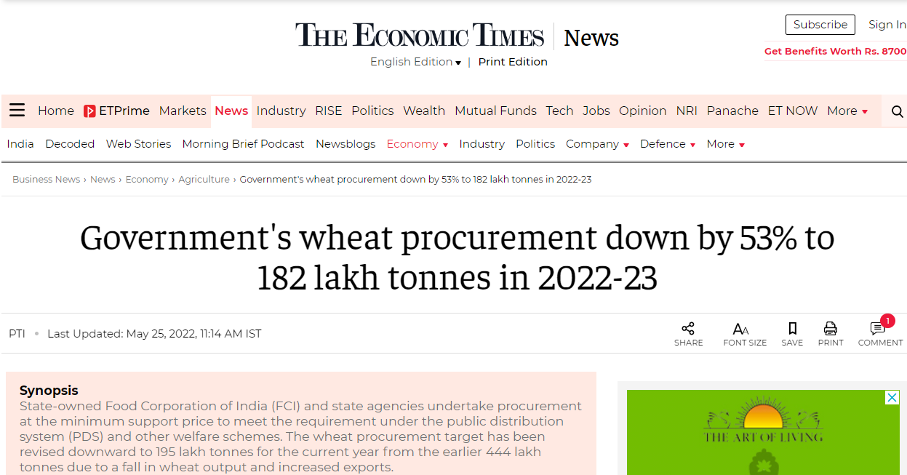
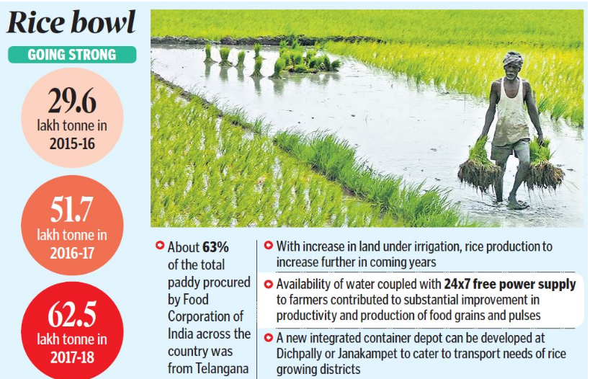

Slide 8

Literature Review :
Niketa Gandhi ," Rice Crop Yield Forecasting of Tropical Wet and Dry Climatic Zone of India Using Data Mining Techniques", IEEE International Conference on Advances in Computer Applications (ICACA) , 2016.
Jharna Majumdar, Sneha Naraseeyappa and Shilpa Ankalaki, Analysis of agriculture data using data mining techniques: application of big data, Springer journal,2017.
https://www.ijraset.com/research-paper/agriculture-crop-yield-prediction-using-ml

Slide 9
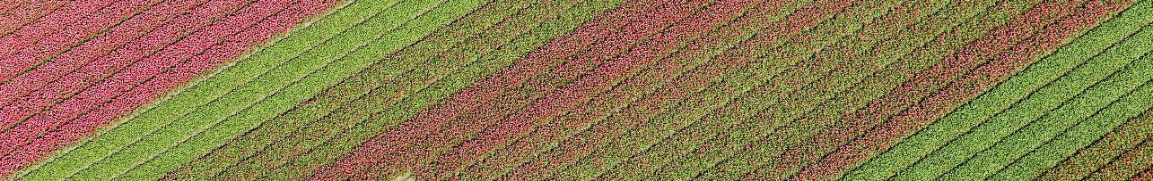
Existing System & Its Disadvantages:
Farmers are growing same crops repeatedly without trying new variety of crops and they are applying fertilizers in random quantity without knowing the deficient content and quantity.
Existing system does not include the features like calculating the PH of soil , temperature, rainfall and humidity. This is directly affecting on crop yield and also causes the soil acidification and damages the top layer.
Farmers will prefer the prior or neighborhood or more trend crop in the surrounding region only for their land and they do not have enough of knowledge about soil nutrients contents such as nitrogen, phosphorous and potassium in the land.
Existing system does not include the features like analyzing the previous year's crops and predicting the new crop.

Slide 10
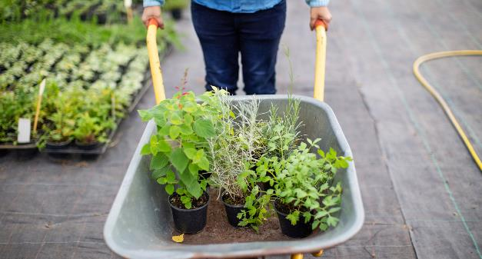
Software Requirements:
IDE : JUPYTER NOTEBOOK / GOOGLE COLLAB
Machine Learning Algorithms
Scikit-Learn
K-Nearest Neighbor(KNN)
Naive Bayes
Decision Tree Algorithm
Python libraries
Numpy
Pandas
Scipy
Matplotlib
Hardware REQUIREMENTS
8GB RAM
512GB Hard Disk
I5 Processor
IDE : JUPYTER NOTEBOOK / GOOGLE COLLAB

Slide 11
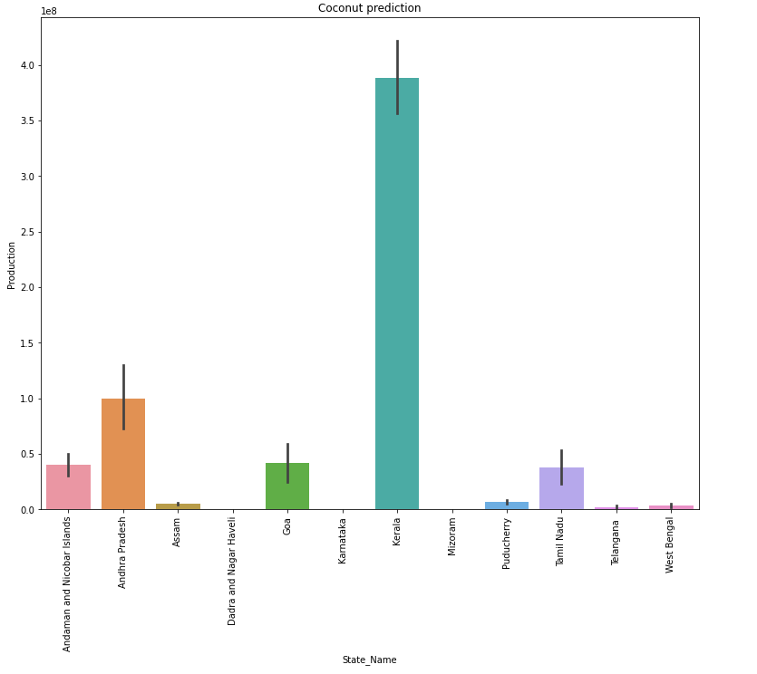
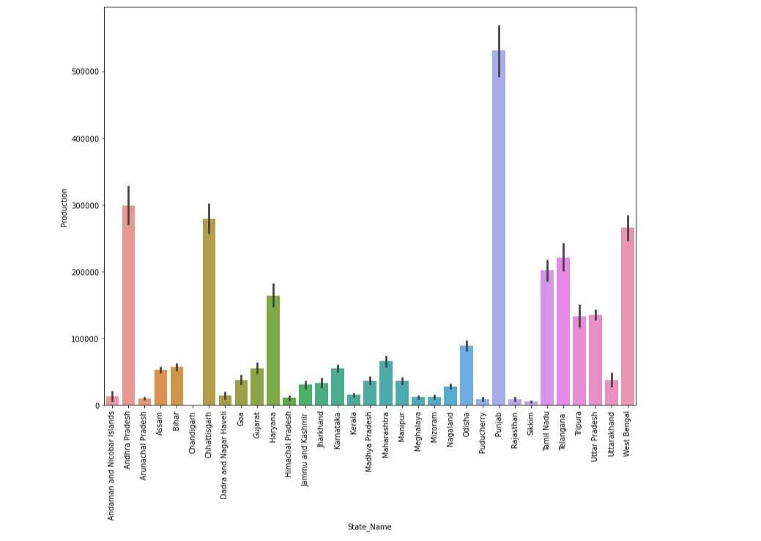
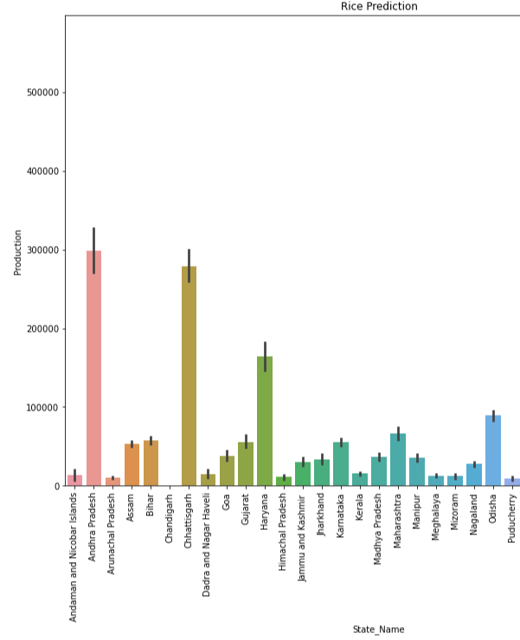
Data Analysis

Slide 12
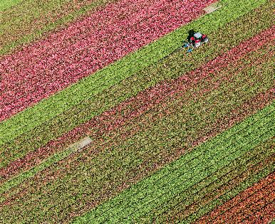
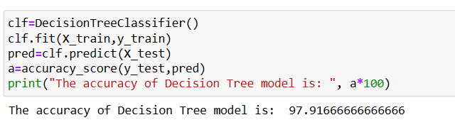
Algorithm’s Used:
Decision Tree Algorithm :
A decision tree is a flowchart-like tree structure where each internal node denotes the feature, branches denote the rules and the leaf nodes denote the result of the algorithm. It is a versatile supervised machine-learning algorithm, which is used for both classification and regression problems. It is one of the very powerful algorithms.
The goal of using a Decision Tree is to create a training model that can use to predict the class or value of the target variable by learning simple decision rules inferred from prior data(training data).
Construction of Decision Tree: A tree can be “learned” by splitting the source set into subsets based on Attribute Selection Measures. Attribute selection measure (ASM) is a criterion used in decision tree algorithms to evaluate the usefulness of different attributes for splitting a dataset.

Slide 13
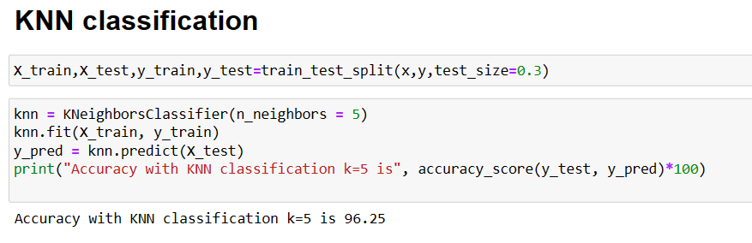
K-Nearest Neighbor(KNN) Algorithm
K-Nearest Neighbours is one of the most basic yet essential classification algorithms in Machine Learning. It belongs to the supervised learning domain and finds intense application in pattern recognition, data mining, and intrusion detection.
It is widely disposable in real-life scenarios since it is non-parametric, it does not make any underlying assumptions about the distribution of data .
The KNN algorithm helps us identify the nearest points or the groups for a query point. But to determine the closest groups or the nearest points for a query point we need some metric. For this purpose, we use below distance metrics:
Euclidean Distance
Manhattan Distance
Minkowski Distance

Slide 14
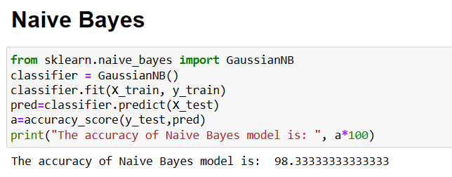
Naïve Bayes
Naive Bayes classifiers are a collection of classification algorithms based on Bayes’ Theorem. It is not a single algorithm but a family of algorithms where all of them share a common principle, i.e. every pair of features being classified is independent of each other.

Slide 15
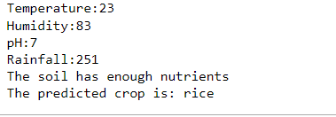
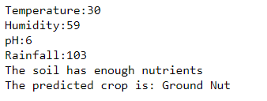
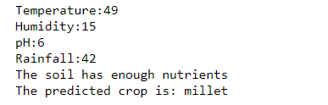
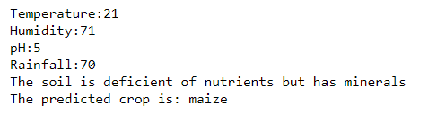
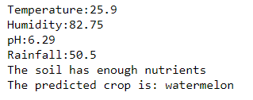
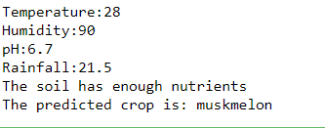
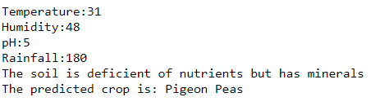
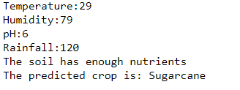

Slide 16
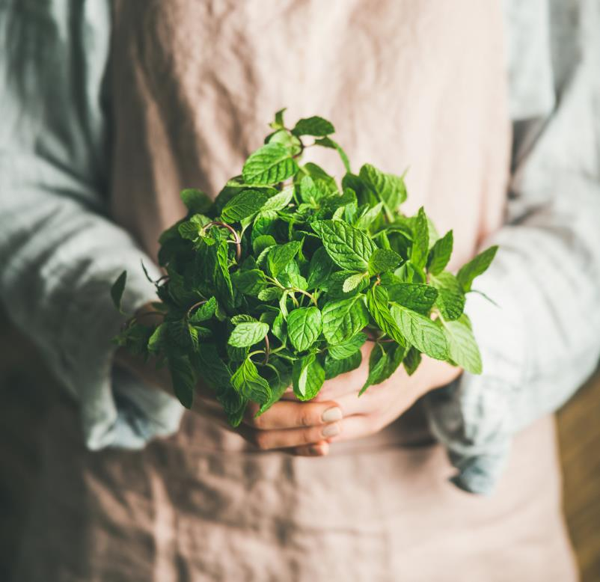
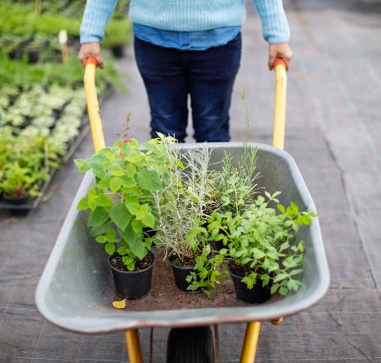
References :
https://github.com/okolomaduabuchimatthew/Crop-Yield-Prediction-and-Analysis
https://www.kaggle.com/datasets/siddharthss/crop-recommendation
https://ieeexplore.ieee.org/document/9311735
https://www.ijraset.com/research-paper/agriculture-crop-yield-prediction-using-ml

Slide 17
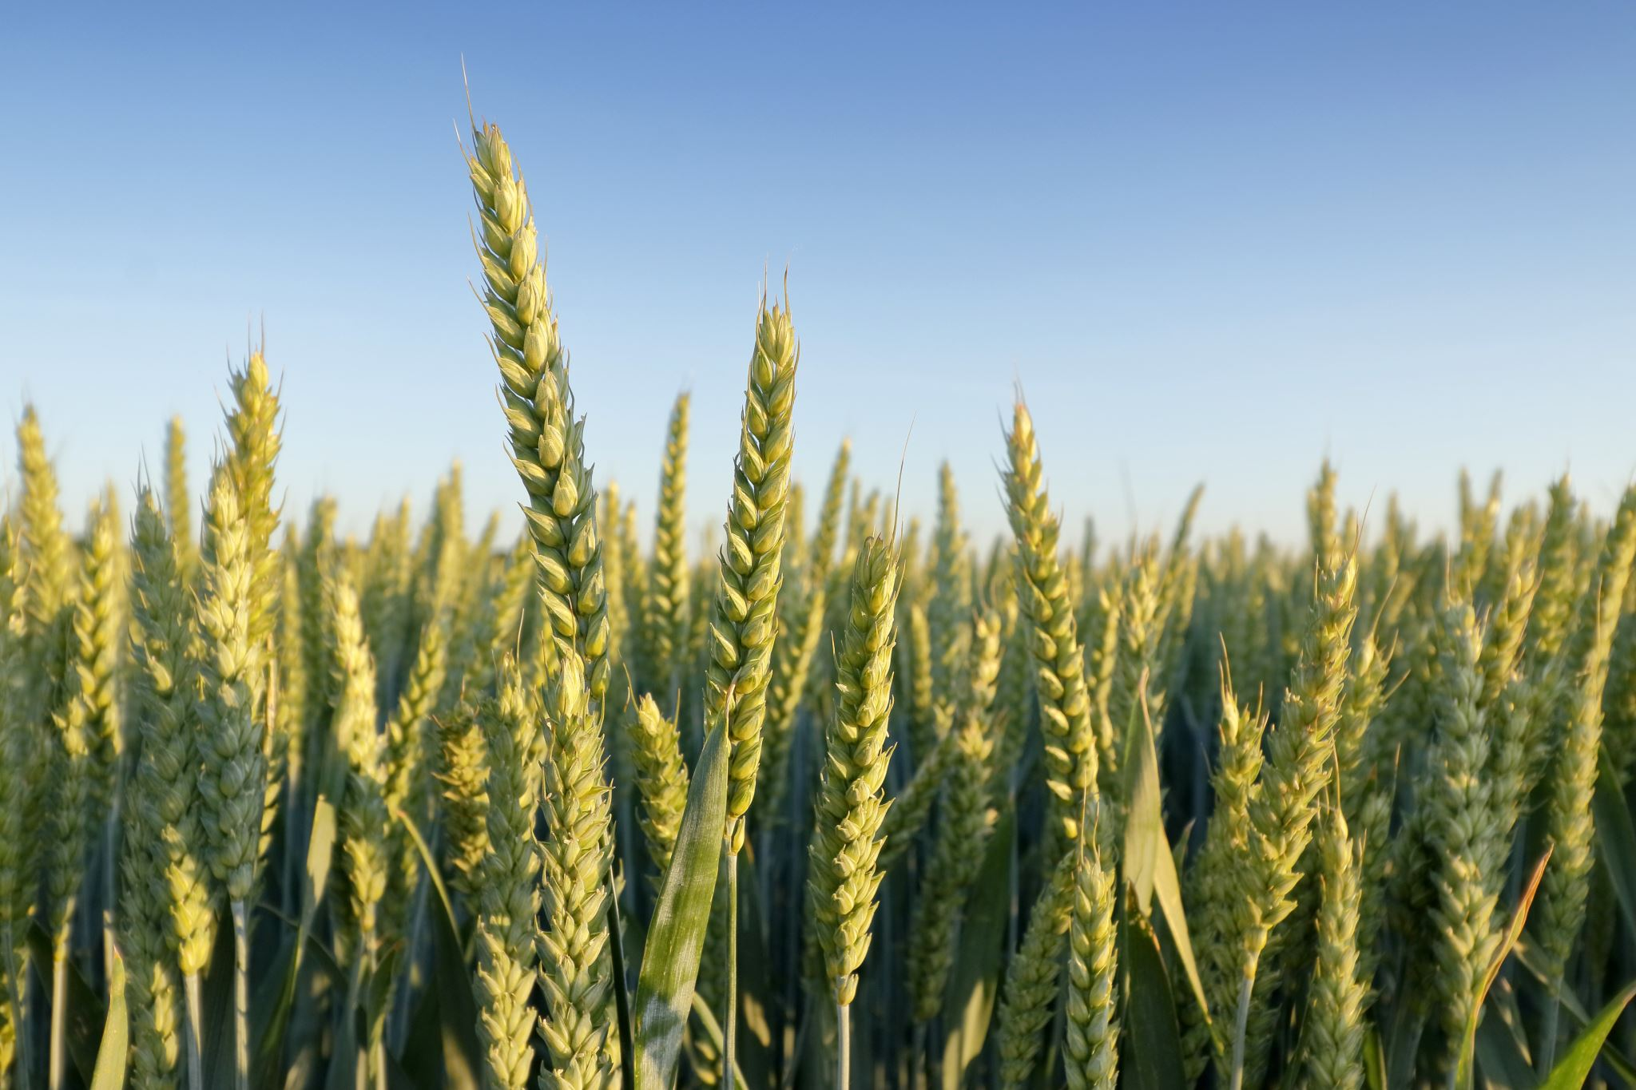
Objectives:
Next Crop Prediction
Benefits to Farmers, Government And Common People

Slide 18
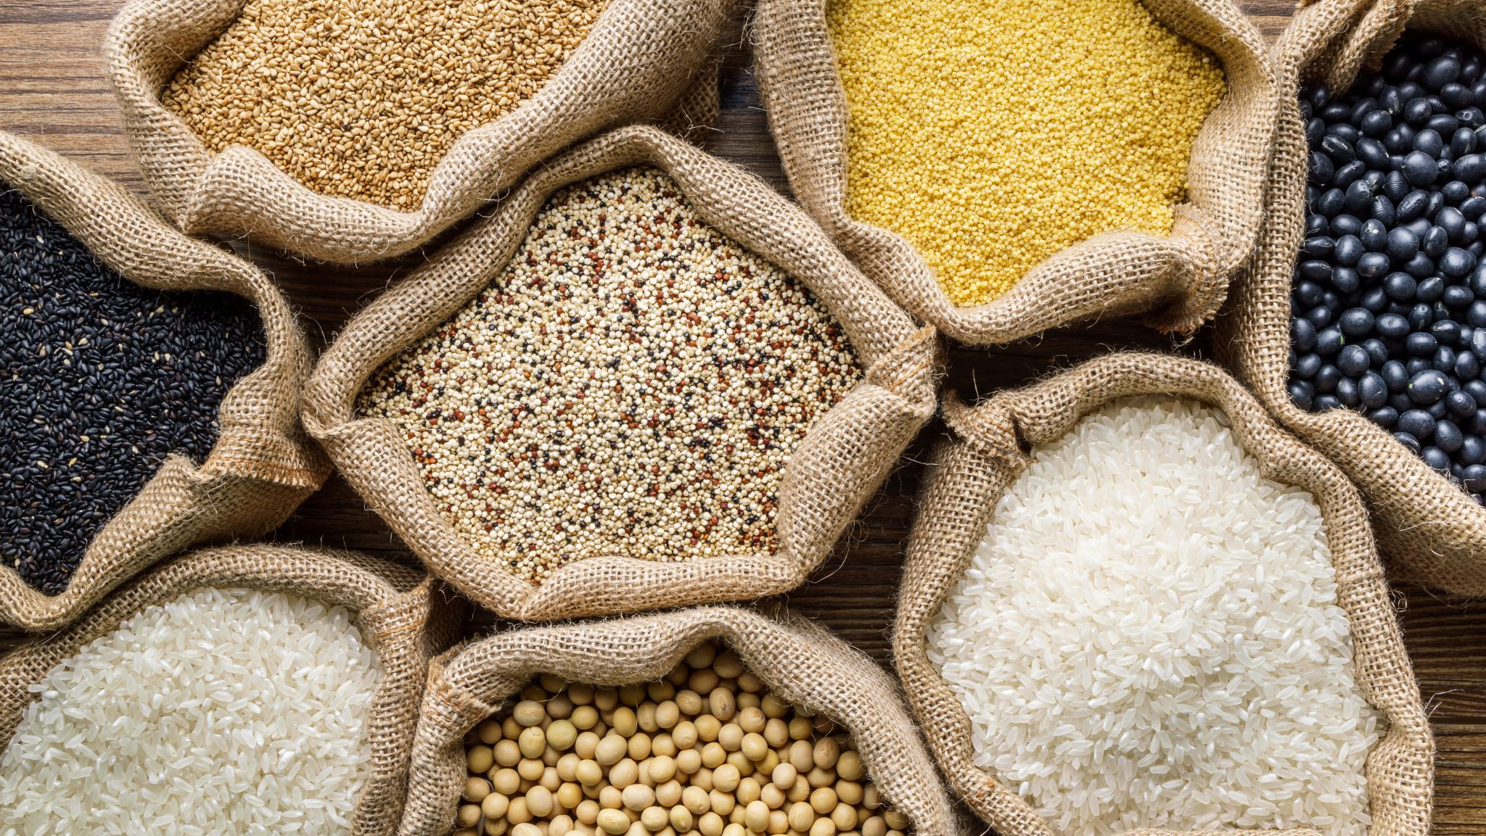
THANK YOU
Aditya Vachani(20AG1A6702)
Alijala Akash(20AG1A6706)
Buru Rakesh(20AG1A6713)
Kadari Harshavardhan Reddy(20AG1A6728)
Katkam Sathwik(20AG1A6730)

